Slide 1
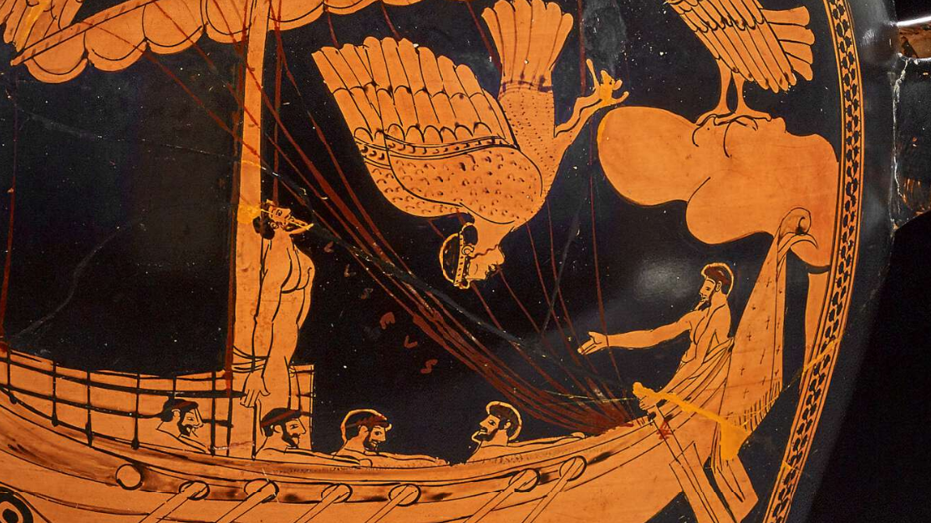
Welcome and Course Orientation

Slide 2
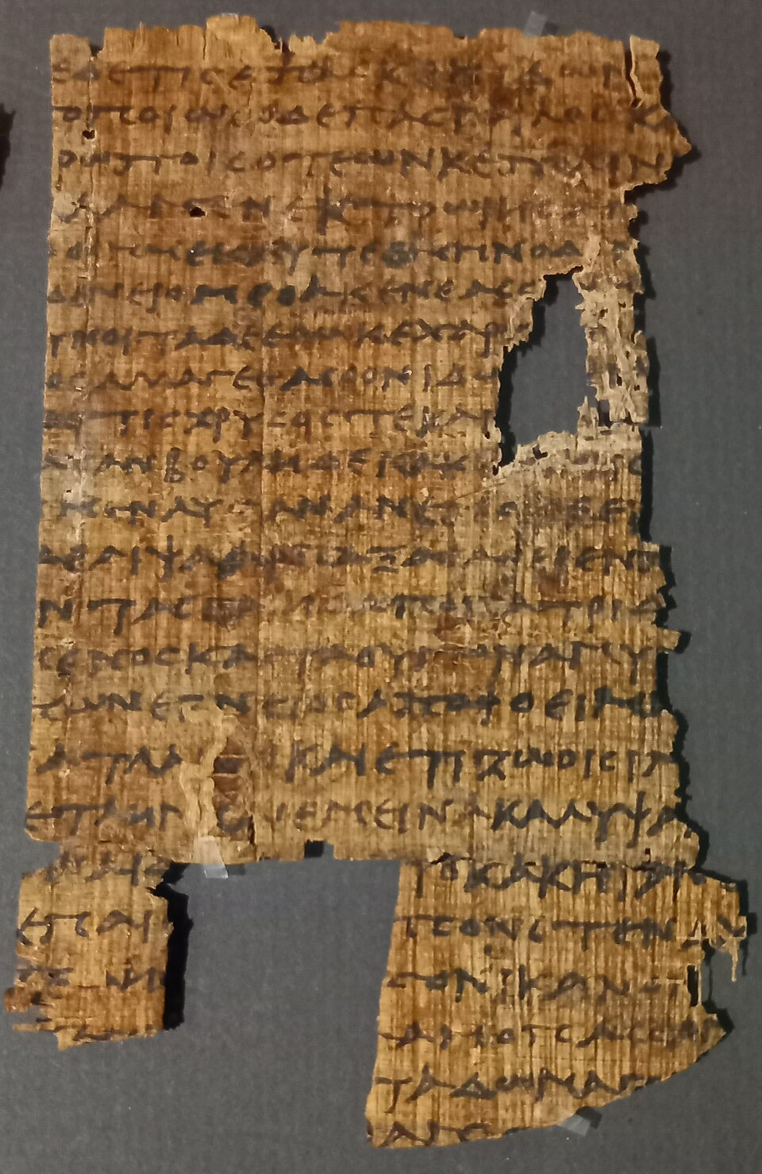
How familiar are you with The Odyssey?
□ I've never read it.
□ I've read excerpts.
□ I've read or listened to the whole story.
□ I've studied it in a class.

Slide 3
1. Who is the hero of The Odyssey?
a. Achilles
b. Odysseus
c. Hector
d. Agamemnon

Slide 4
2. What is the name of Odysseus's wife?
a. Helen
b. Athena
c. Penelope
d. Circe

Slide 5
3. What is the name of Odysseus's son?
a. Paris
b. Telemachus
c. Menelaus
d. Nestor

Slide 6
4. From which war is Odysseus trying to return home?
a. Persian War
b. Peloponnesian War
c. Trojan War
d. Punic War

Slide 7
5. What is Odysseus' homeland?
a. Sparta
b. Ithaca
c. Athens
d. Crete

Slide 8
6. Which one-eyed giant does Odysseus encounter?
a. The Minotaur
b. Polyphemus
c. Cerberus
d. Charybdis

Slide 9
7. Which goddess often helps Odysseus?
a. Hera
b. Aphrodite
c. Athena
d. Artemis

Slide 10
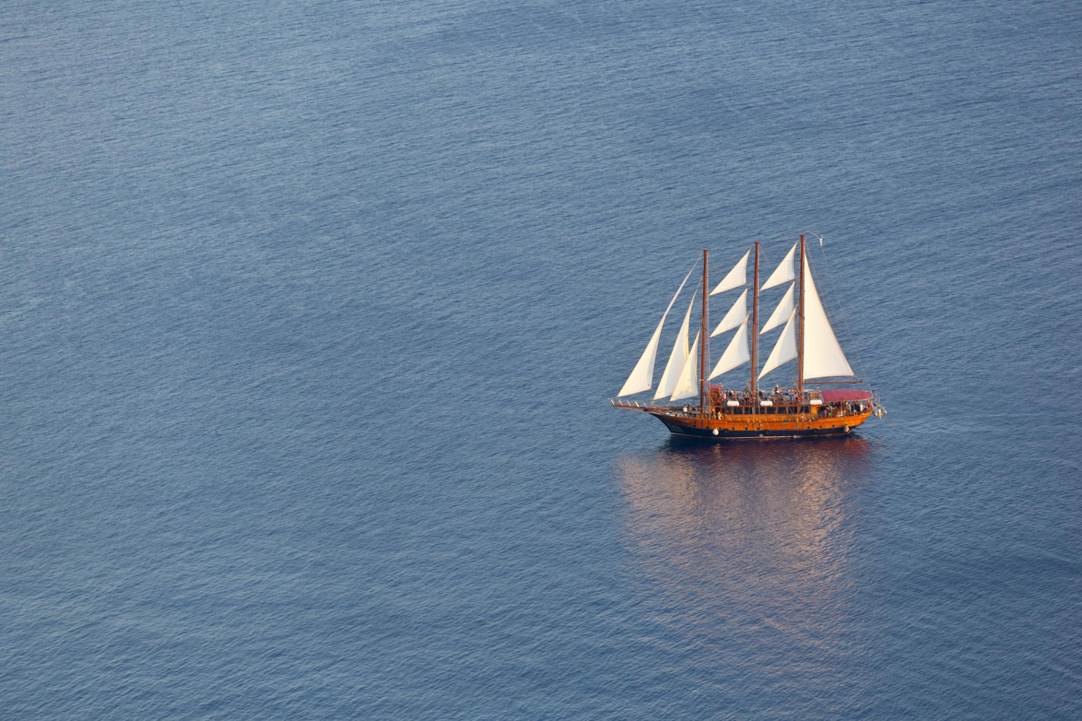
Week 1 – Setting Sail:
Introduction to The Odyssey
Exploring the journey and themes of the epic poem

Slide 11
Course Outline
  Week One – Setting Sail
  Cultural context, oral tradition, epic poetry, the story, structure,
  and characters of The Odyssey
  Week Two –
  Books 1–4: The Telemachy
  Books 5–8: Odysseus Freed from Calypso
  Week Three –
  Books 9–12: Odysseus’ Wanderings
  Week Five –
  Books 17–20: The Beggar in the Palace
  Books 21–24: Revenge and Restoration
  Week Four –
  Books 13–16: Return to Ithaca

Slide 12

What else do you want to know?

Slide 13
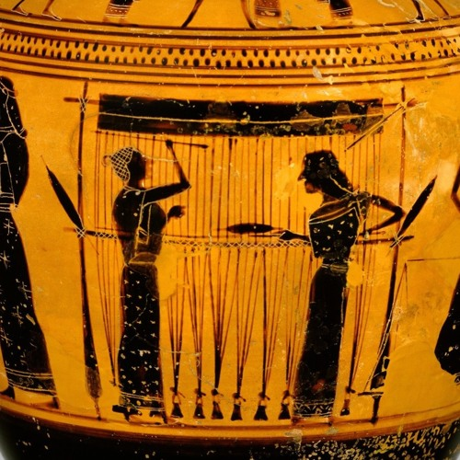

Woven Through the Weeks…
The Women
  Wisdom in women; female power; how female characters shape the narrative.
Xenia
How guest-friendship influences and protects – and the consequences of ignoring it!
Identity
How Odysseus changes during his journey and how the world is shifting from the Heroic Age of the Iliad to something new.

Slide 14
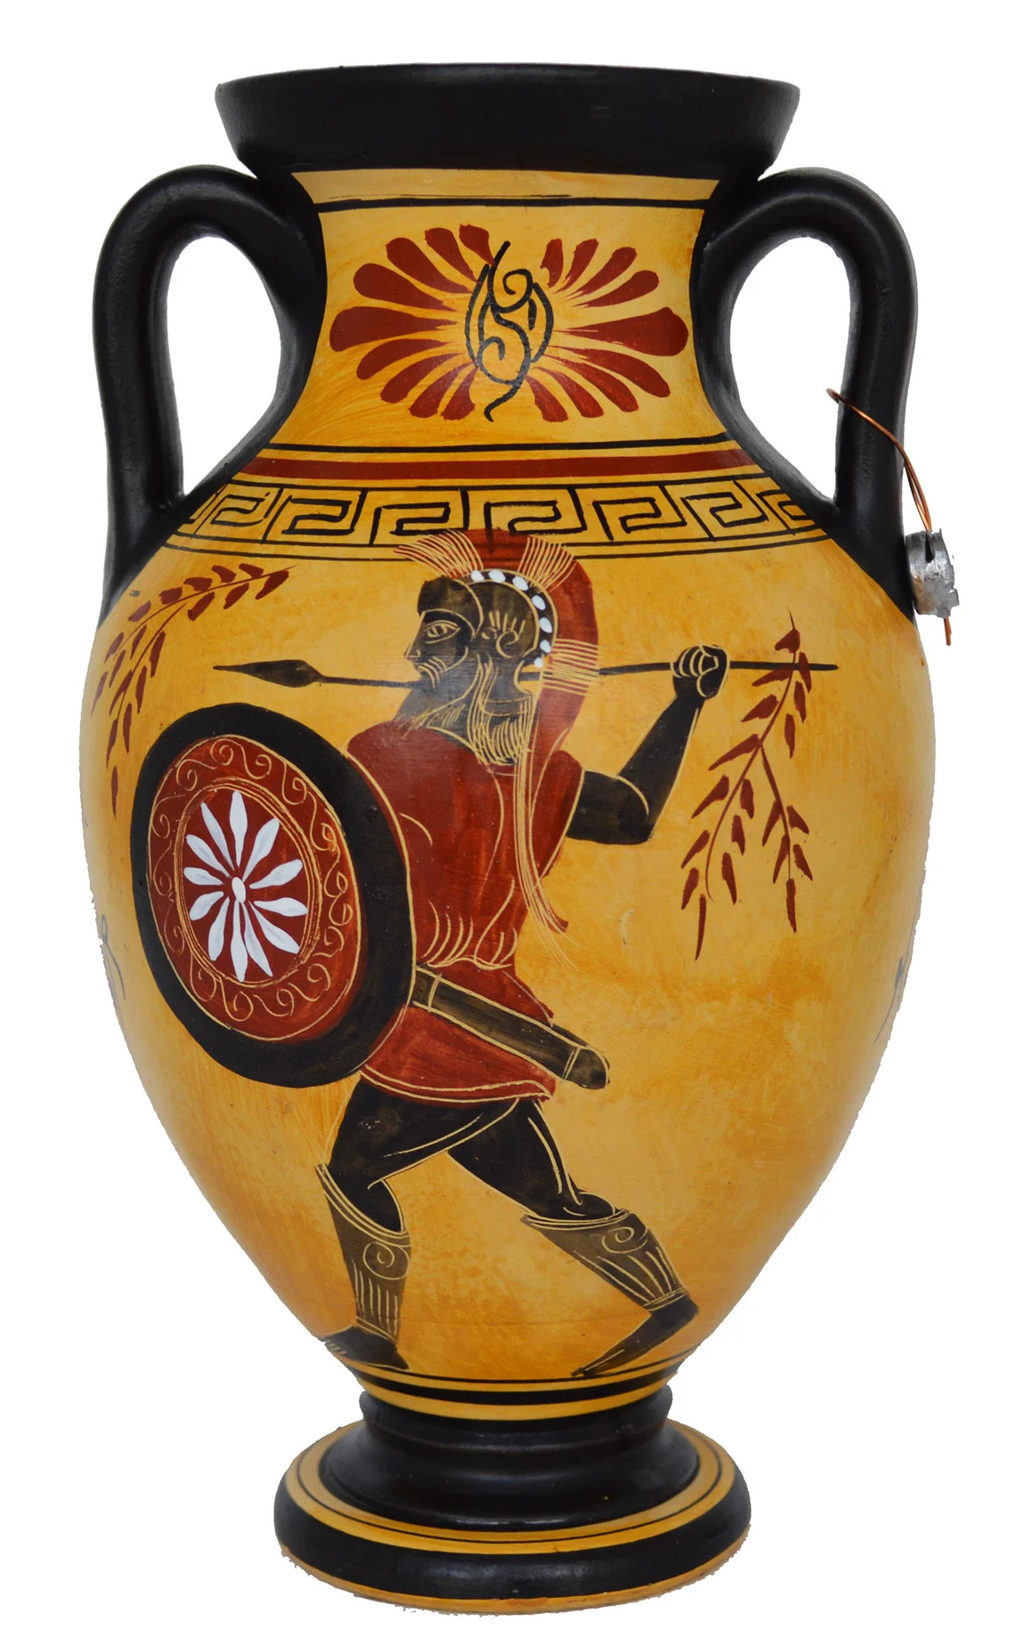
Setting the Tone for Our Journey Through The Odyssey
Curiosity
  The course explores The Odyssey as a shared intellectual journey.
Inclusivity
We all have different understandings, perspectives, and opinions.
Sharing Ideas
  Everyone brings something to the conversation – don’t be afraid to explore and share your thoughts.
Enjoyment
There’s a surprising amount of humor in The Odyssey. Remember to have fun!

Slide 15
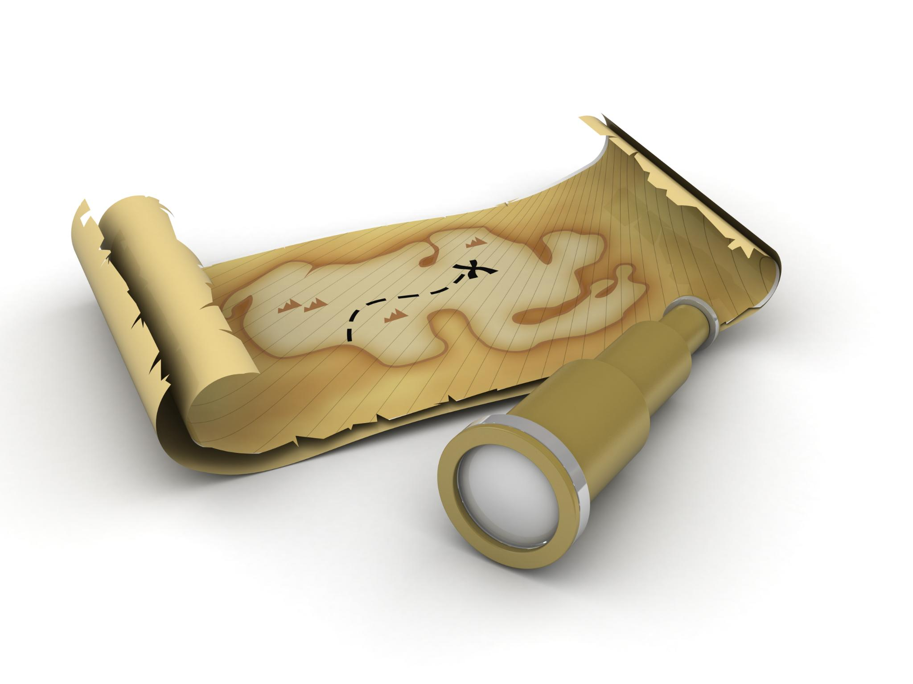
Learning Goals for Week One
Cultural context of ancient Greece in Homer’s time (e.g. values like hospitality, role of the gods) and how they set the stage for The Odyssey.
Understanding Epics
  Exploring epics as long narrative poems about extraordinary deeds influenced by cultural values.
Oral Tradition
  The Odyssey was meant to be performed and heard, featuring repetition, formal speech, and vivid imagery.
The Poem
  The Odyssey’s structure and some of its themes.

Slide 16
The Homeric Question
  The 8th century BCE poet who put the Iliad and Odyssey on parchment, is traditionally known as “Homer”.
  The epics were likely shaped by multiple bards over decades, but for simplicity we refer to Homer as the author.
c. 8th–7th century BCE: Iliad composed in oral tradition; no single author named “Homer” is attested.
c. 7th century BCE: Hesiod and other early writers begin to name Homer as the poet of the epics.
5th century BCE: Attribution to Homer becomes standard in Greek literature and education.
Later antiquity and modern times: “Homer” is accepted as the author in both classical and modern scholarship, though with the caveat that the attribution is a later literary convention.

Slide 17
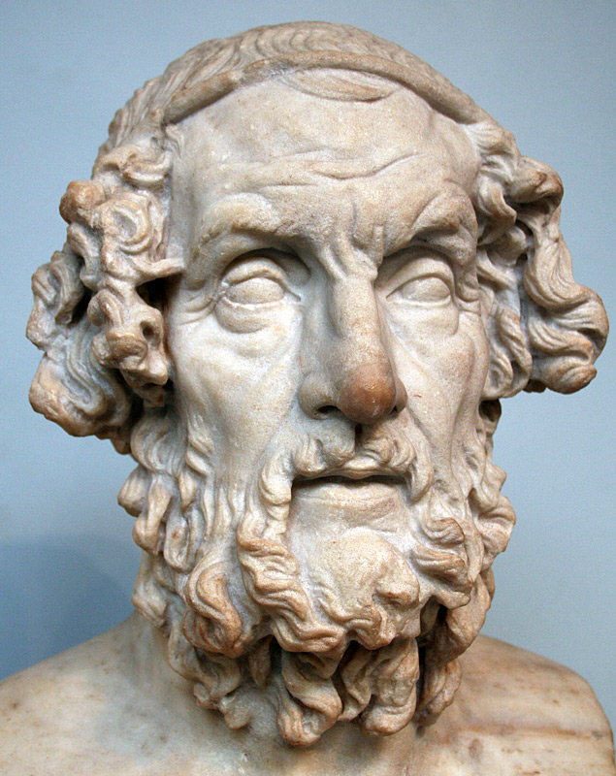
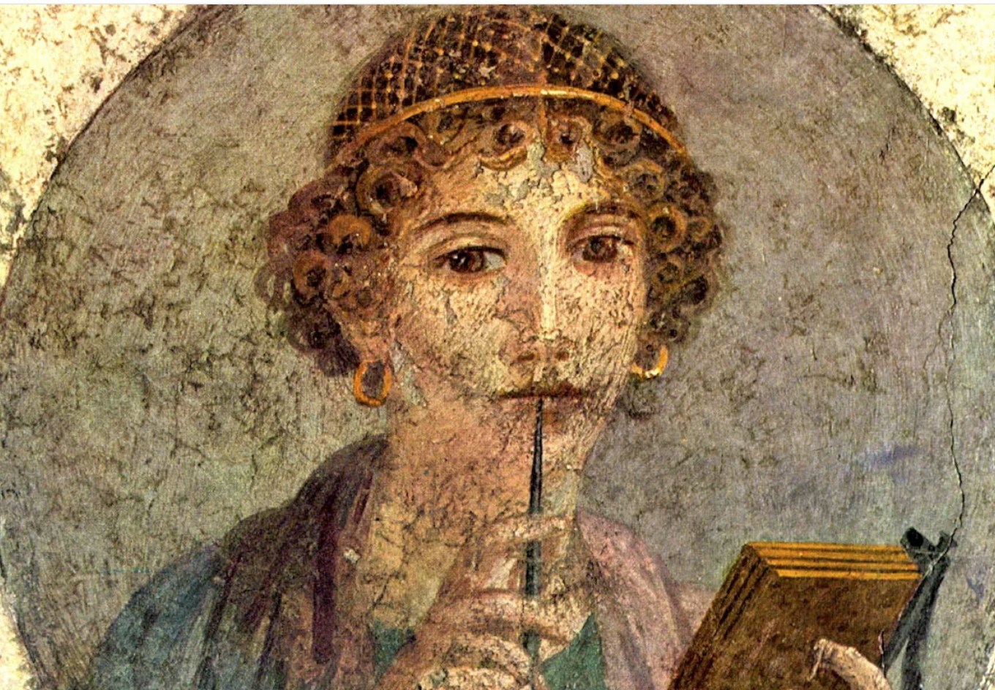


Slide 18
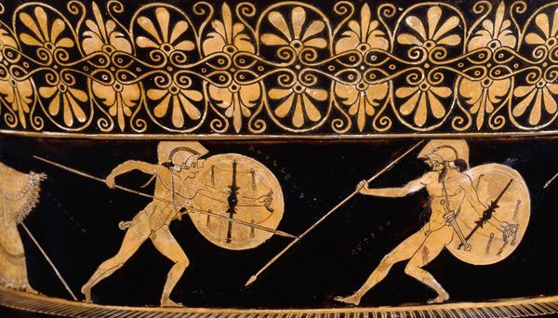
The World of Homer
Understanding the World Behind The Odyssey

Slide 19
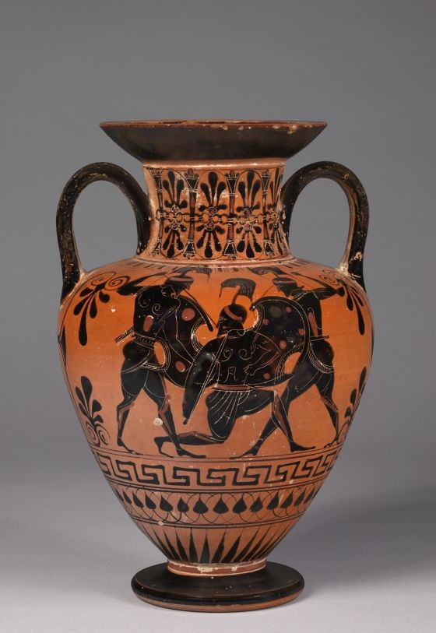
The Archaic Period
8th century BCE (800–701 BCE) , known as the Archaic Period.
One of the most important turning points in
Greek history.
Greece was emerging from a Dark Age, after
the collapse of the Mycenaean civilization around 1100 BCE.
A World of Small Communities
The Rise of Trade and Colonization
Religion Everywhere
Writing Returns to Greece

Slide 20
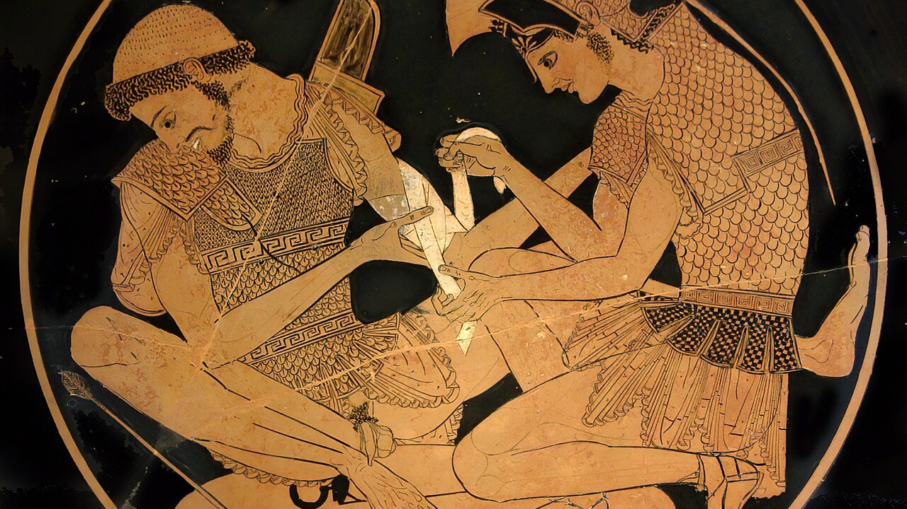
Epic Poetry and Oral Tradition

Slide 21
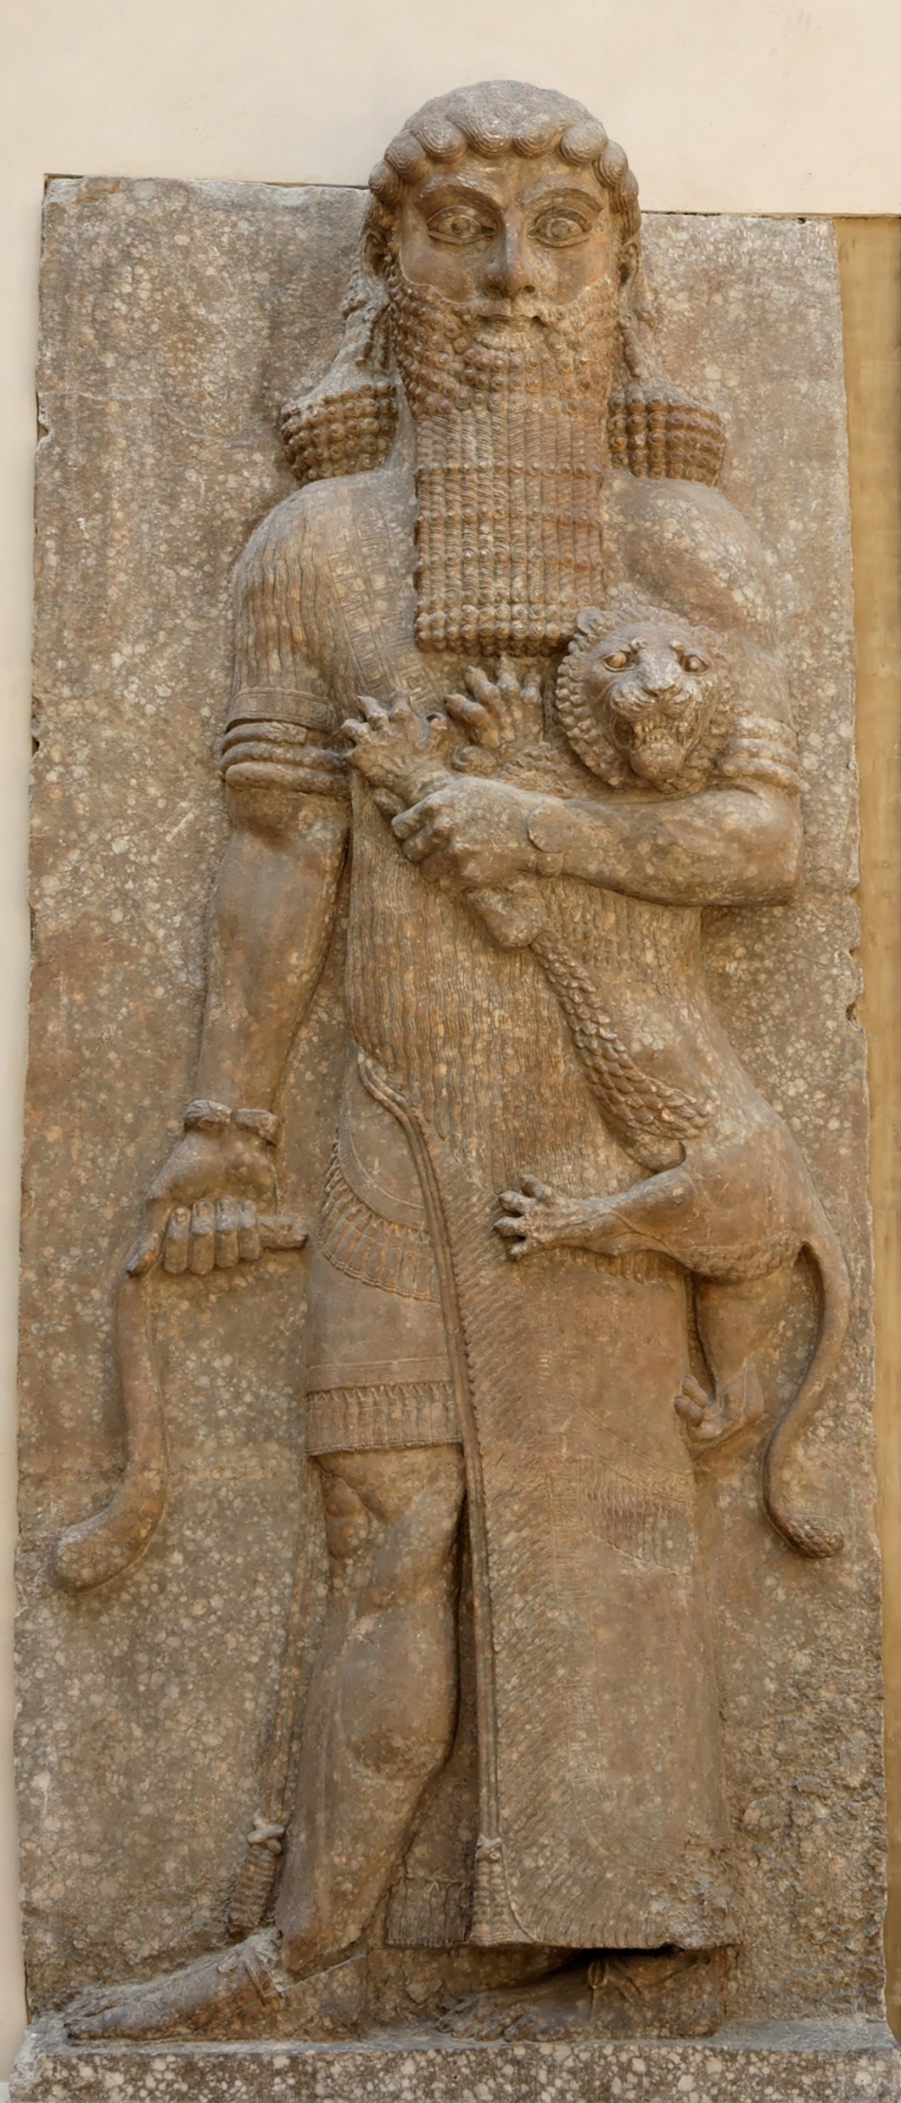
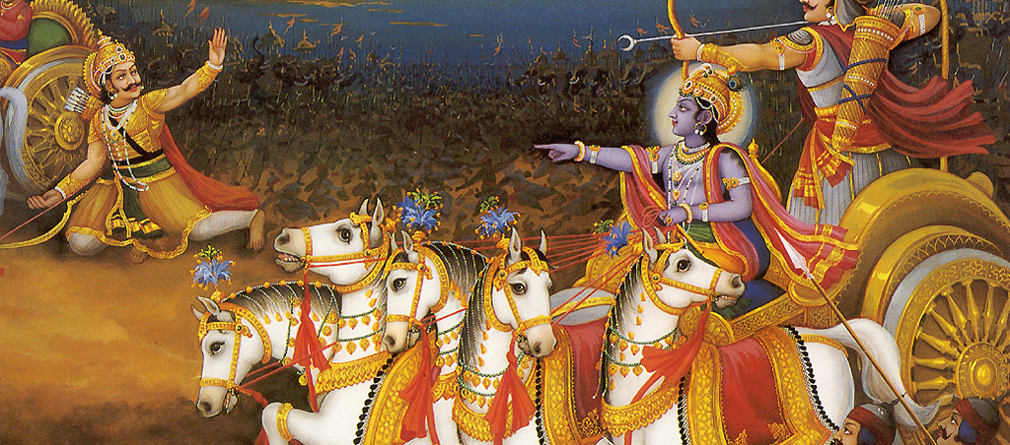
Epic Poems

Slide 22
What Is An Epic Poem?
  Long narrative poem describing the actions and / or travels of a heroic character
  The language is stylized and elevated
  Greek epic poems were originally composed orally, and not written down until centuries later
  Subject matter is serious
  The poems use specific techniques such as formulaic epithets and similes
  Embodies societal values
  Purpose is to instruct and entertain

Slide 23
Techniques and Formulae
Epithets
Homeric similes
Repetition
Meter and rhythm
Emily Wilson recites the opening lines

Slide 24
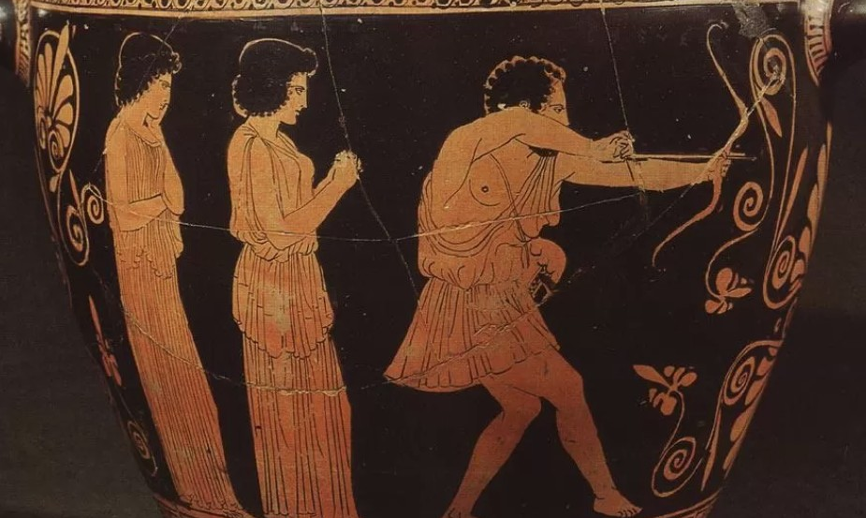
The Odyssey

Slide 25
What is the Odyssey?
  One of the earliest and most influential works in Western literature.
  It’s an epic poem (over 12,000 lines, divided into 24 books)
  It recounts the adventures of Odysseus, a Greek hero, as he strives to return home after the ten-year long Trojan War.
  Odysseus’ journey from Troy to Ithaca lasts an additional ten years, during which time he encounters many perils and all of his crewmates are killed.
  In Odysseus's long absence, he is presumed dead, leaving his wife Penelope and son Telemachus to contend with a group of unruly suitors competing for Penelope's hand in marriage.

Slide 26
The Odyssey’s Structure
  Books 1–4: The Telemachy
  Books 5–8: Odysseus Freed from Calypso
  Books 9–12: Odysseus’s Wanderings
  Books 13–16: Return to Ithaca
  Books 17–20: The Beggar in the Palace
  Books 21–24: Revenge and Restoration

Slide 27
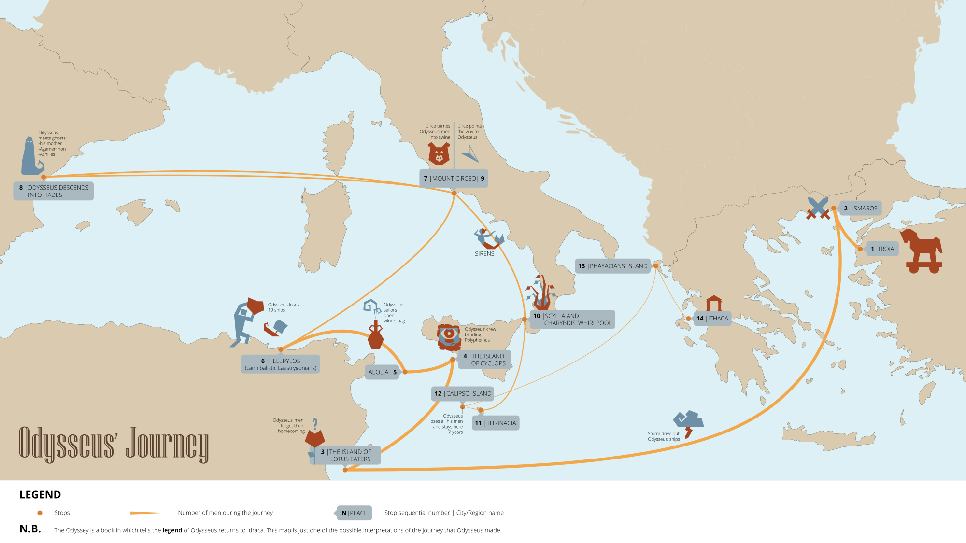

Slide 28
So…What’s the Iliad?
The Trojan War, dated by later Greek authors to the 12th or 13th century BCE, was a legendary conflict between the Achaeans (Greeks) and the Trojans.
It was triggered by the abduction of Helen, wife of Menelaus of Sparta, by Paris, son of King Priam of Troy.
According to myth, the war lasted ten years and involved a coalition of Greek states besieging Troy.
The Iliad is an epic poem set during the tenth year of the Trojan War. The central narrative revolves around Achilles, the greatest Greek warrior, and his anger toward Agamemnon, the leader of the Greek forces.
The poem explores themes of honor, wrath, fate, and mortality, and depicts both large-scale battles and intimate human interactions.

Slide 29
How Are They Different?
The Iliad is about war, the Odyssey is about peace, home, family. We see domestic rituals, hospitality, domestic scenes. There are also many ritualized activities in the Iliad, but most relate to war.
In the Odyssey, the gods often feel a sense of responsibility towards mortals. In The Iliad, the gods use mortals as pawns for their own ends.
The Iliad is a linear narrative, the Odyssey is not (self-consciously not)
The Iliad focuses on nobles and gods, the Odyssey gives room to all levels of society.

Slide 30
Major Themes
Nostos (homecoming)
A theme used in Ancient Greek literature, which includes an epic hero returning home, often by sea.
It was deemed a high level of heroism or greatness for those who managed to return.
Xenia (guest-friendship)
Ancient Greek concept of hospitality. It is rooted in generosity, gift exchange, and reciprocity.
Hospitality towards foreigners and guests was understood as a moral obligation, and honored
Zeus Xenios (and Athene Xenia), patrons of foreigners.
Identity
The world is changing from the Heroic Age of the Iliad to a world with different values and rules.
Odysseus must navigate his way from one way of life to the other.

Slide 31
Why Did Nostos and Xenia Matter So Much?
Nostos was not simply coming home. It was the struggle to recover one's identity, family, and place in the world after war, suffering, and change. The Odyssey asks whether a person can ever truly return to the home they left, or whether both the traveler and the home have been transformed by time.
Xenia established trust, continuity of relationships. Obligation of reciprocity, peace, alliances.
In a world without laws as we know them today, the rule of the gods was binding. To abuse the custom was dangerous.

Slide 32
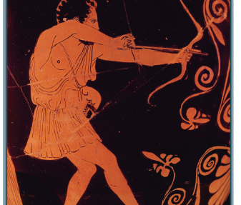
Key Characters in the Odyssey

Slide 33
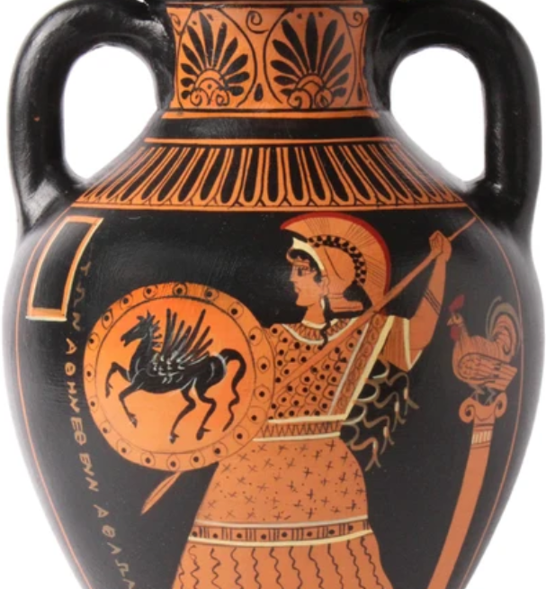
Athene
The goddess of wisdom and warfare, who favors Odysseus and acts as his divine protector and guide throughout his journey. She provides him with strategic advice, intervenes on his behalf with the other gods, and helps him in his final confrontation with the suitors.

Slide 34
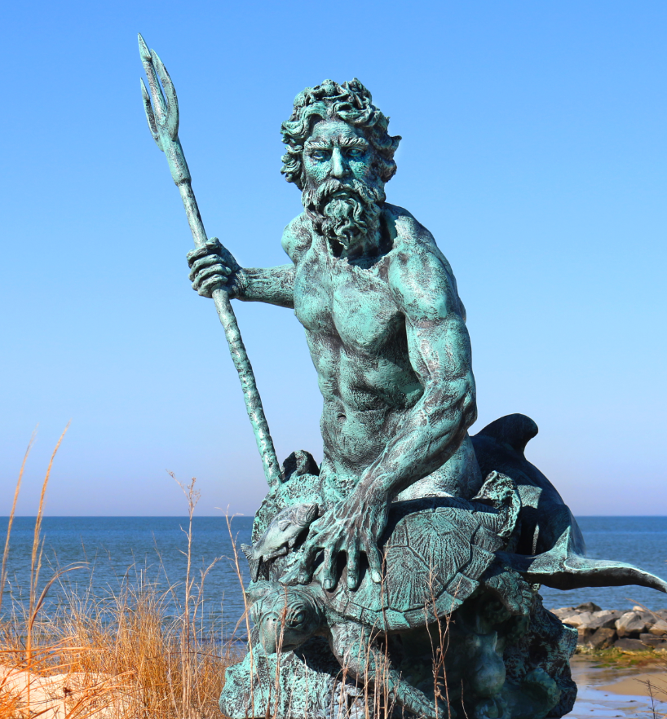
Poseidon
God of the sea, earthquakes, and horses. Odysseus incurs Poseidon’s wrath when he blinded his son, Polyphemus the Cyclops. Poseidon can’t kill Odysseus, , as it is his destiny to return home, he makes every effort to make Odysseus suffer on the way.

Slide 35
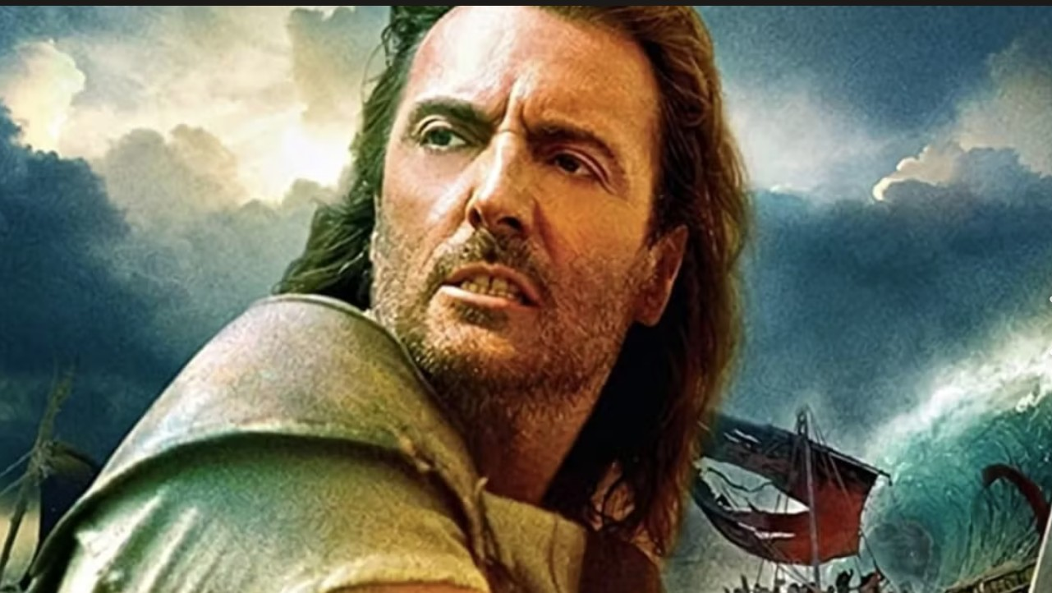
Odysseus
The “many-minded” man.

Slide 36
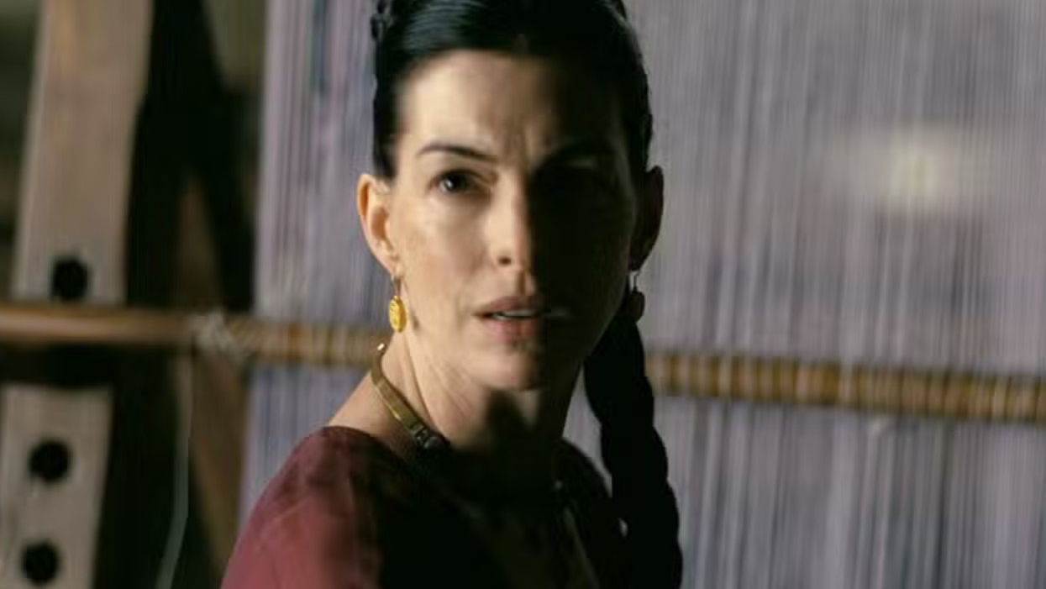
Penelope
Loyal • Intelligent • Patient • Resourceful • Cautious • Resilient • Faithful • Wise.

Slide 37
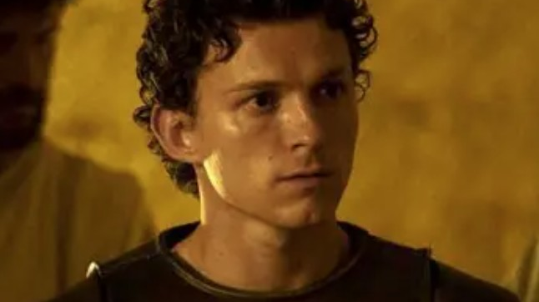
Telemachus
His journey is to become an adult.

Slide 38
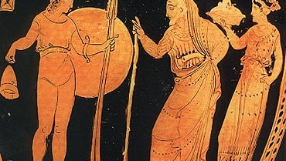

Looking Ahead

Slide 39
Connecting Week One to Week Two
  Homework!
  Read books 1–4: The Telemachy, and 5–8: Odysseus Freed from Calypso
  We will keep in mind the following themes:
    Xenia and its key role
    The role of the women
    Nostos, and the concept of the journey home
    The poem’s structure

Slide 40
Consider These Two Questions:
Why do you think the Odyssey still resonates after ~2,700 years? What universal themes or experiences might explain why people around the world continue to read and retell this story?
Look for examples of guest-friendship. How do the hosts and guests behave? What do they talk about?

